Slide 1
Basic concepts of algorithms

Slide 2
Overview
An introduction to some of the basic concepts of computer algorithms for network calculations
  Particularly data structures for storing networks and methods for estimating the time computations will take
Analysis involved in the contemporary study of networks is primarily performed using computers.
  We are concerned with networks that have thousands or even millions of vertices.
Discuss some simple but important ideas about the running time of algorithms and data structures for the storage of networks
Notes:
2

Slide 3
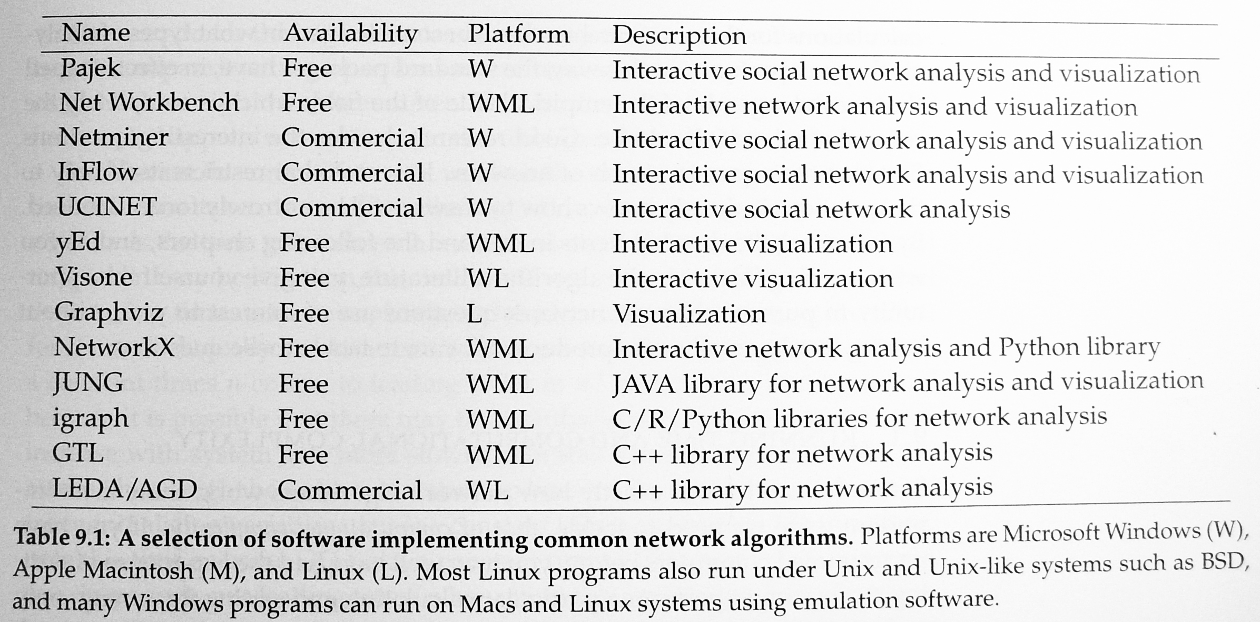
Overview

Slide 4
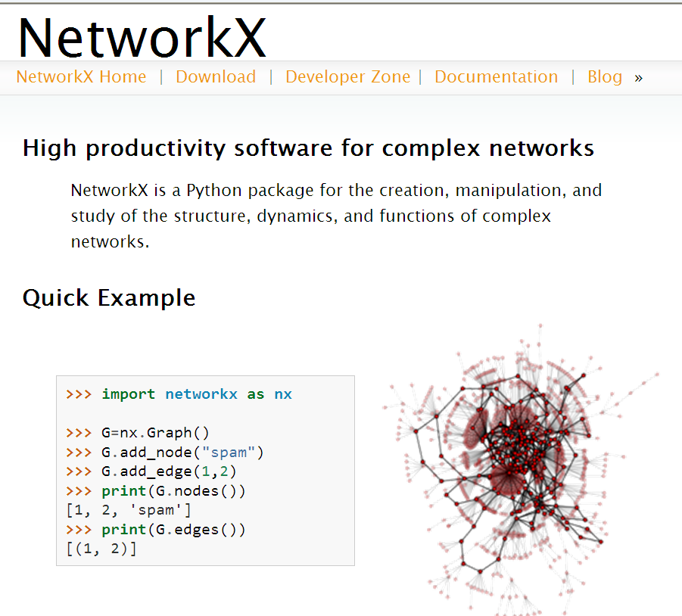
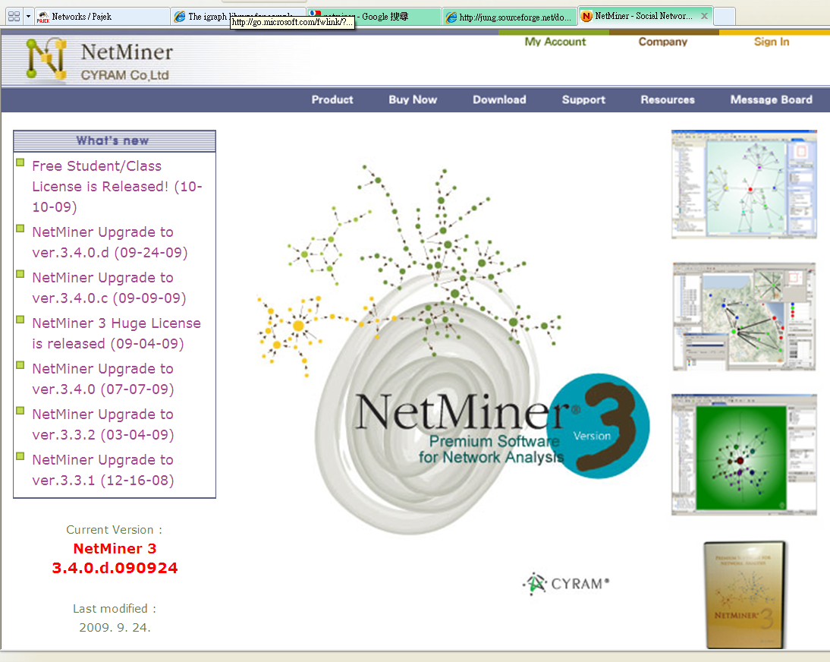
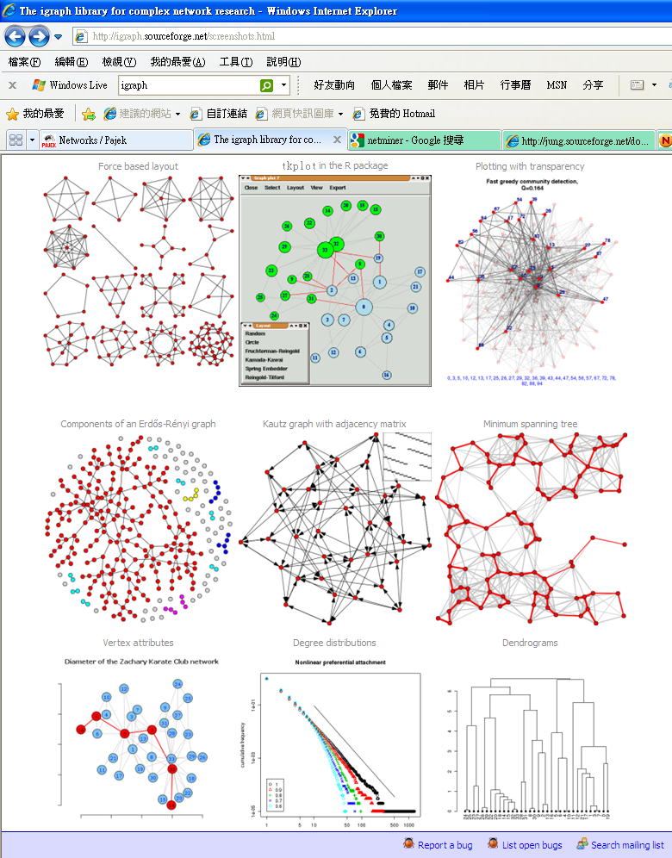
Screen shot of the igraph

Slide 5
Outline
Runing time and computational complexity
Storing network data
The adjacency matrix
The adjacency list
Trees
Other network representations
Heaps

Slide 6
Outline
Runing time and computational complexity
Storing network data
The adjacency matrix
The adjacency list
Trees
Other network representations
Heaps
Notes:
6

Slide 7
Running time and computational complexity
Definition
  Computational complexity:
    A measure of the running time of a computer algorithm
  Simple example: how long does it take to find the largest number in a list of n numbers?
Purpose
  Help us to avoid wasting our energies on programs
Computational complexity of an algorithm is an indication of how the algorithm’s running time scales with the size of its input

Slide 8
Running time and computational complexity
The importance of the computation complexity lies in its use for estimating the actual running time of real algorithms.
  a month, a year or a century
The knowledge of the computational complexity allows us to do that by measuring run-time on a small problem and then scaling up appropriately to the size of the real problem.
Computation complexity (time complexity): the running time as a function of the input size.
O(n): the running time varies as a constant times n or less.
O(1): independent of the size of the input n.

Slide 9
Running time and computational complexity
In many of the network algorithms
  The number of vertices n will be the important parameter we consider.
  In other cases, the important parameter will be the number of edges m in the network
  In others, we need both m and n to fully specify the size of the input
“Breadth-first search” example
  Finding geodesic paths in networks
  Computational complexity O(m) + O(n)
    m edges and n vertices
    It runs in time am + bn, where a and b are constants
  Sloppy form: O(m+n)
    This notation does not imply that the constants in front of m and n are the same

Slide 10
Running time and computational complexity
In a lot of networks research, we are concerned with sparse graphs
  m increases in proportion to n as n becomes large
  mean degree of the network:
  O(m+n)≡O(n)

Slide 11
Running time and computational complexity
Breadth-first search algorithm
  O(m+n)
  A small test run
    n = 1000 vertices and m = 10000 edges
    The program finishes in a second
  The full network
    n = 1,000,000 and m = 10,000,000
    A thousand times larger than the test network
    A thousand seconds = about a quarter of an hour

Slide 12
Running time and computational complexity
Algorithm with compuational complexity O(n⁴)
  Test network takes a second
  Full network would take a trillion seconds ➔ 30,000 years
  Look for a faster algorithm that can complete it in reasonable time.
In practice,any algorithm that scales with system size as O(n³) or greater is useless for large networks

Slide 13
Outline
Runing time and computational complexity
Storing network data
The adjacency matrix
The adjacency list
Trees
Other network representations
Heaps
Notes:
13

Slide 14
Storing Network Data
The first task of most programs that work with network data
  Read data
    From computer file ➔ store it in some form in the memory
Commonest ways to store network data
  The first step in representing a network in a computer is to label the vertices so that each can be uniquely identified
  The simplest case: number n vertices by the consecutive integers.
  Additional values attached
    Social network : the vertices might have names
    World wide web : the vertices might have URLs
    Internet : the vertices might have IP addresses or AS numbers
    Other properties: age, capacity, or weight

Slide 15
Outline
Runing time and computational complexity
Storing network data
The adjacency matrix
The adjacency list
Trees
Other network representations
Heaps
Notes:
15

Slide 16
The Adjacency Matrix
The adjacency matrix provides one of the simplest ways to represent a network on a computer
To add an edge, to remove an edge, and to test wheter there is an edge between a given pair of vertices i and j only take a constant amount of time regardless of the size of the network.
Drawbacks
  Undirected networks
    If we want to add an undirected edge between vertices i and j, then in principle we should increase both the ijth and jith elements of the adjacency matrix by one.
    In practice, this is a waste of time.
    A better approach is to update only elements in the upper triangle of the matrix and leave the lower one empty.
    Why waste memory storing it?
    10¹⁰ bytes of RAM (10GB) and an integer requires 4 bytes
      4n² = 10¹⁰ → n = 50,000
  Run quickly through the neighbors of a particular vertex on a sparse network
    Go through all the elements of the ith row one by one looking for those that are non-zero.
    This takes time O(n).
    Most of time is wasted because each vertex is connected to only a small fraction of the others and most of the elements in the adjacency matrix are zero.

Slide 17
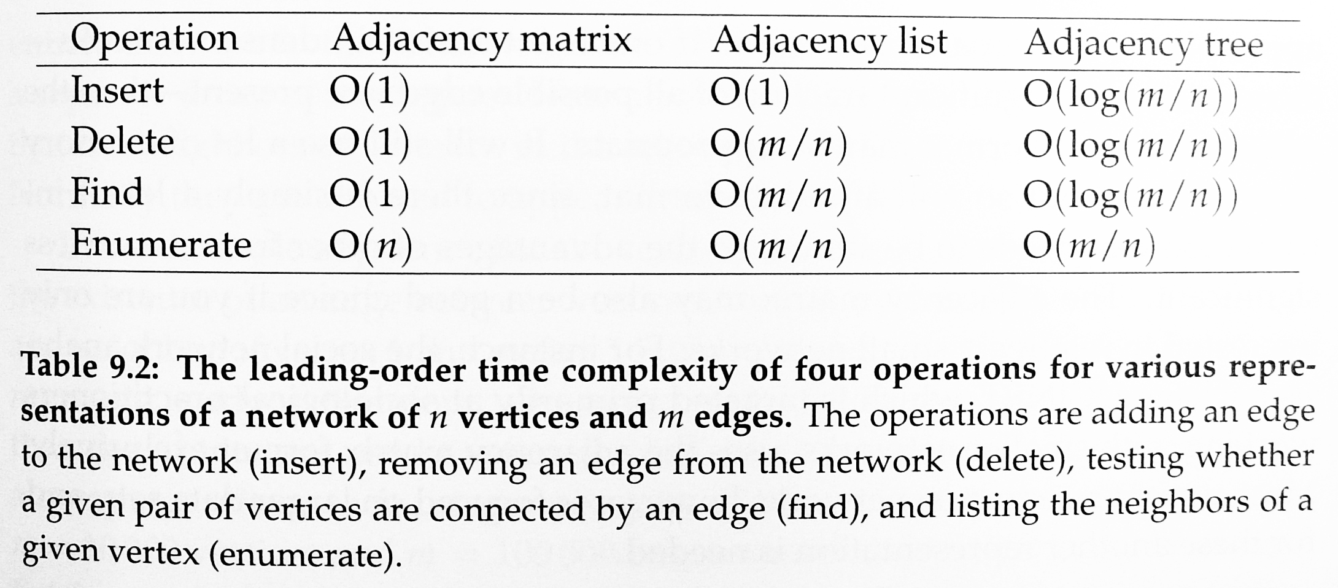
Complexity comparison

Slide 18
Outline
Runing time and computational complexity
Storing network data
The adjacency matrix
The adjacency list
Trees
Other network representations
Heaps
Notes:
18

Slide 19
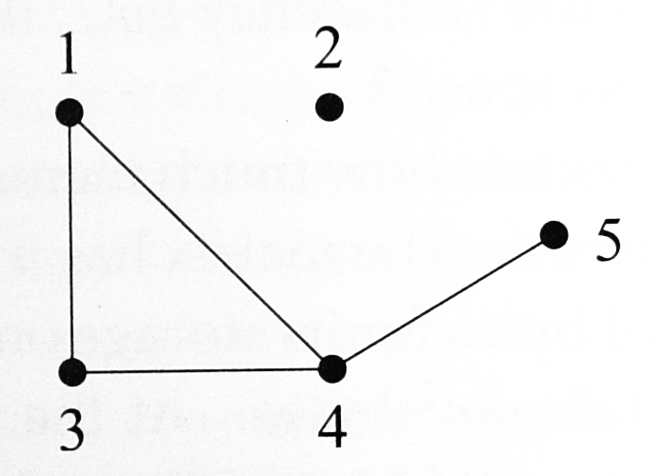
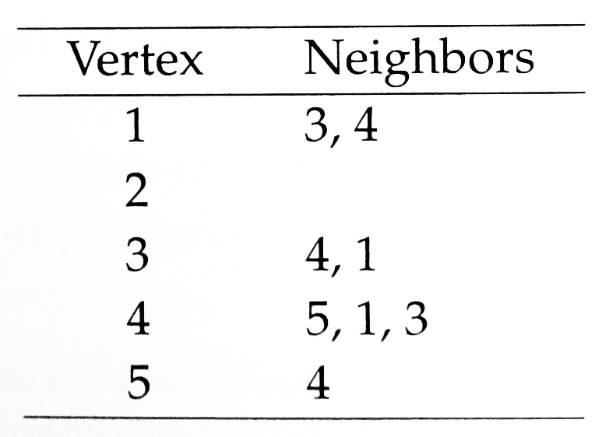
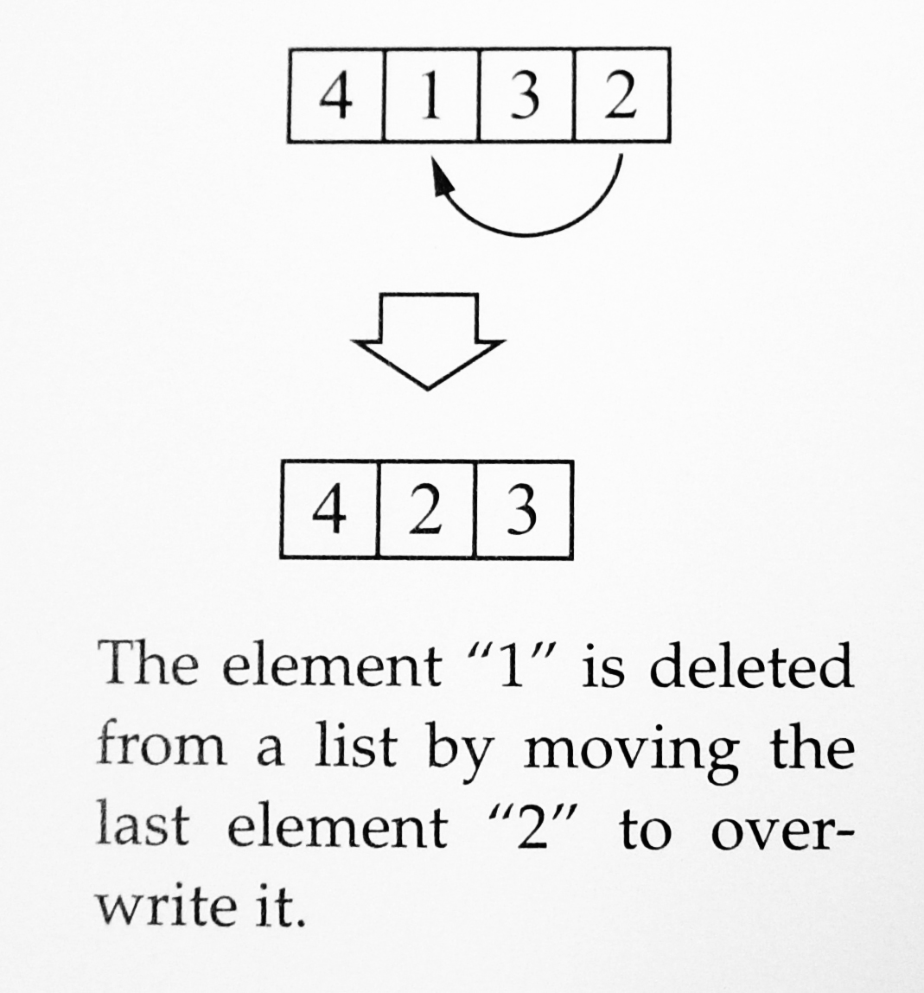
The adjacency list
The simplest alternative to storing the complete adjacency matrix of a network
Memory calculation
  n=10,000 m=100,000
  Integer = 4 bytes
  Adjacency list: 2 x 4 x m = 800kB
  Adjacency matrix: 4 x n² = 400MB
Computational complexity
  To add an edge (i,j) → O(1)
  Finding an edge → O(m/n)
    Smaller than the same operation using an adjacency matrix
    On a sparse graph with constant mean degree → → O(m/n) ≡ O(1)
  Remove an edge → O(m/n)
    Involves first finding it, which takes time O(m/n)

Slide 20
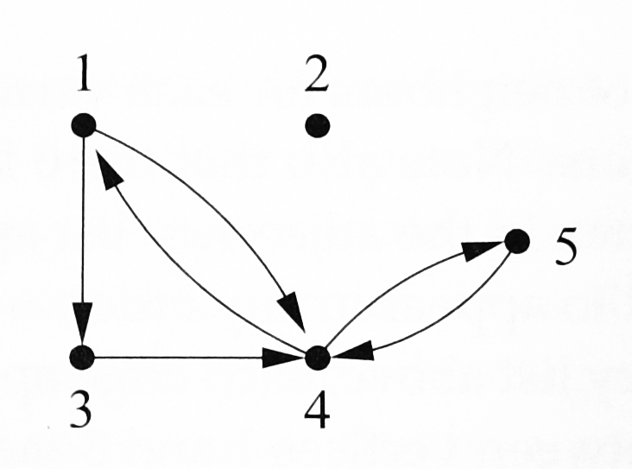
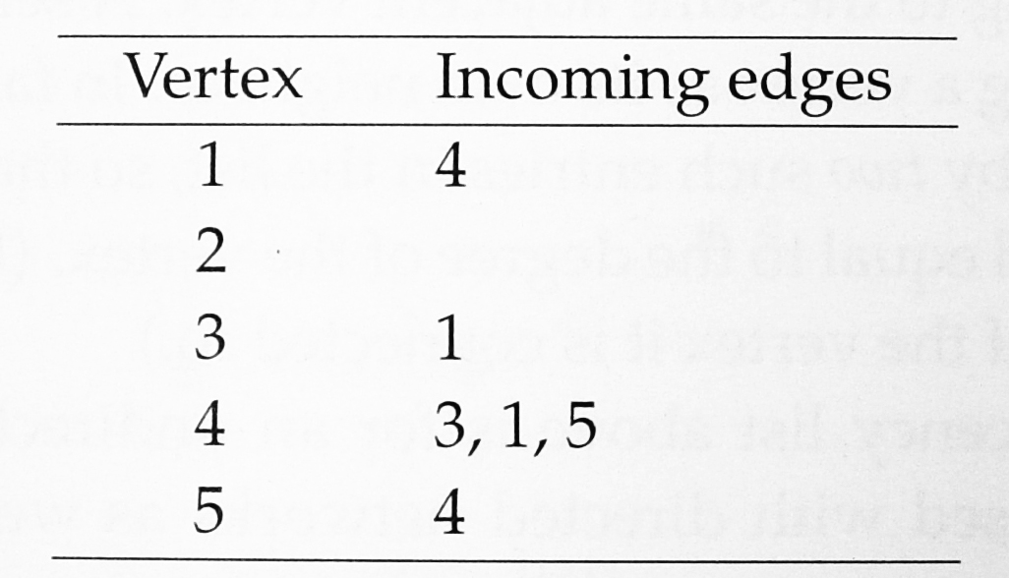
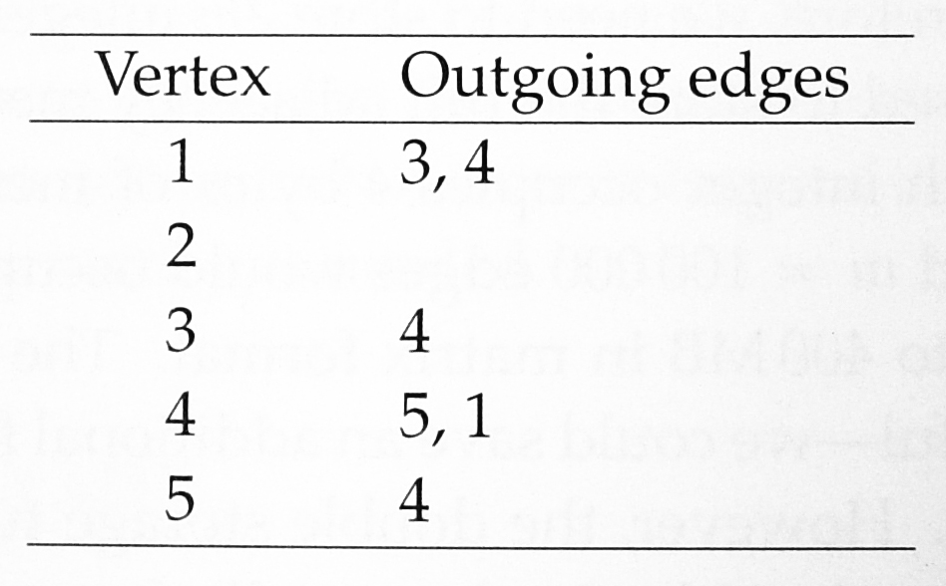
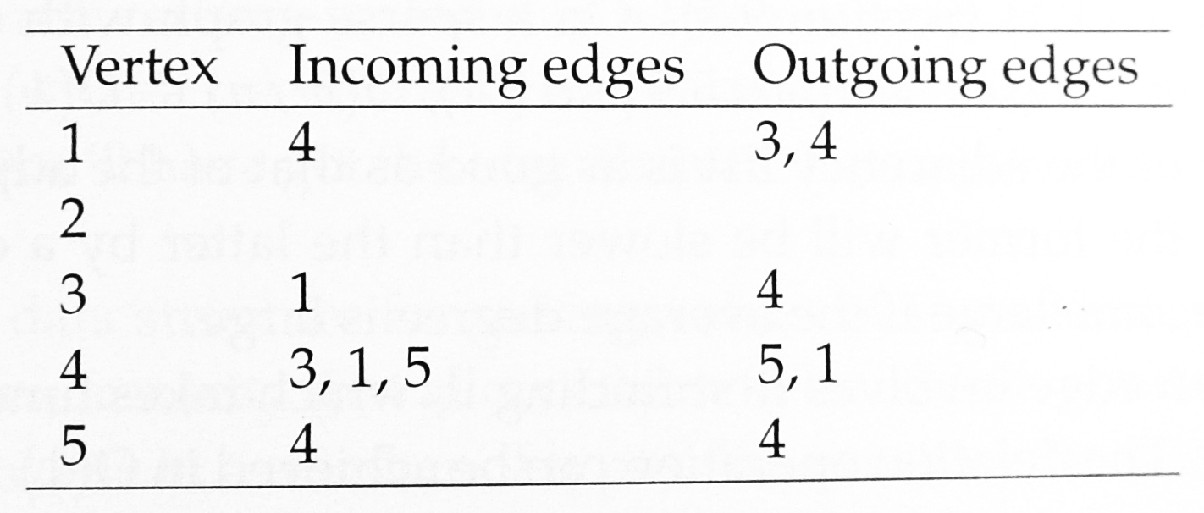
The adjacency list
Directed network
A double adjacency link list
Equivalent representations

Slide 21
Outline
Runing time and computational complexity
Storing network data
The adjacency matrix
The adjacency list
Trees
Other network representations
Heaps
Notes:
21

Slide 22
Trees
A data structure that has most of the advantages of the adjacency list, while being considerably faster in many situations, is the adjacency tree
  The adjacency tree is identical to an adjacency list except that each “row” (where the set of neighbors of each vertex) is stored in a tree rather than a simple array.
    Technically, the structure is not a tree but a forest, i.e., a collection of many trees
    Similarly, the adjacency list is also not a single list but a collection of lists
Property
  The values stored in the left child of node i and in all other nodes descended from that child are less than the values stored in i itself
  Conversely, the values stored in the right child of i and all nodes descended from it are greater than the value stored in i.
…
…

Slide 23
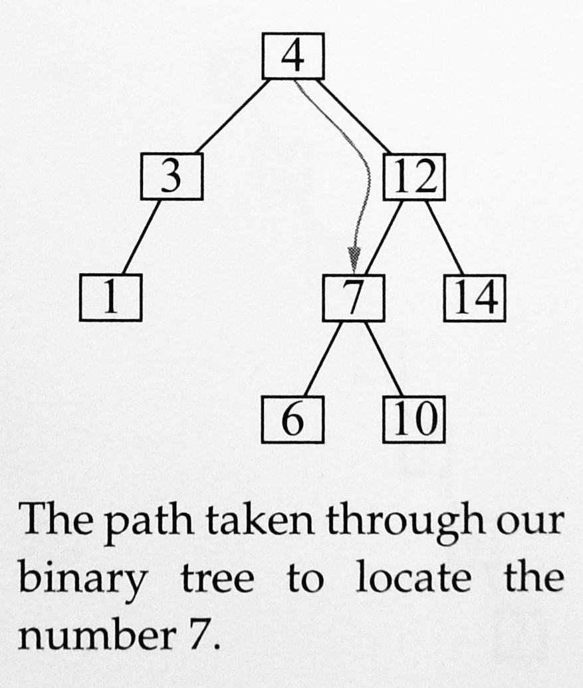
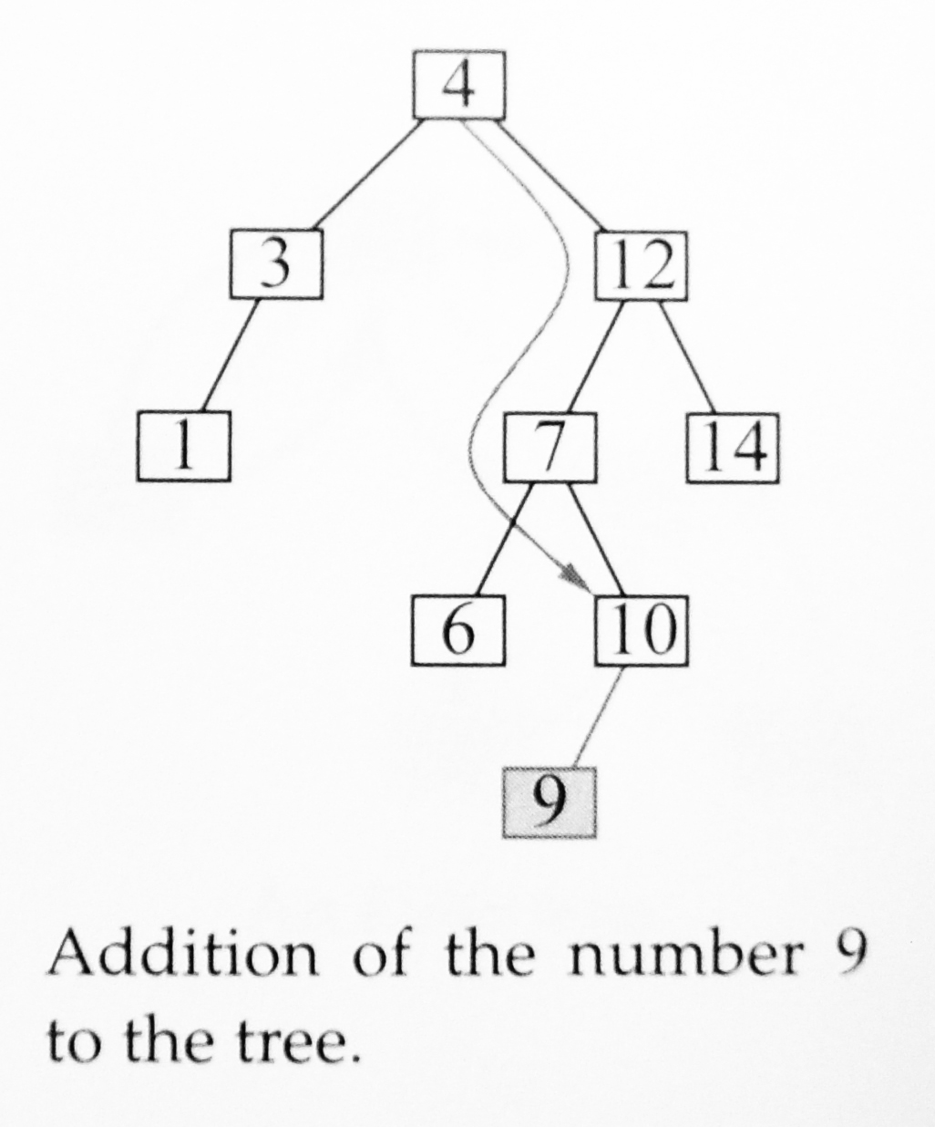
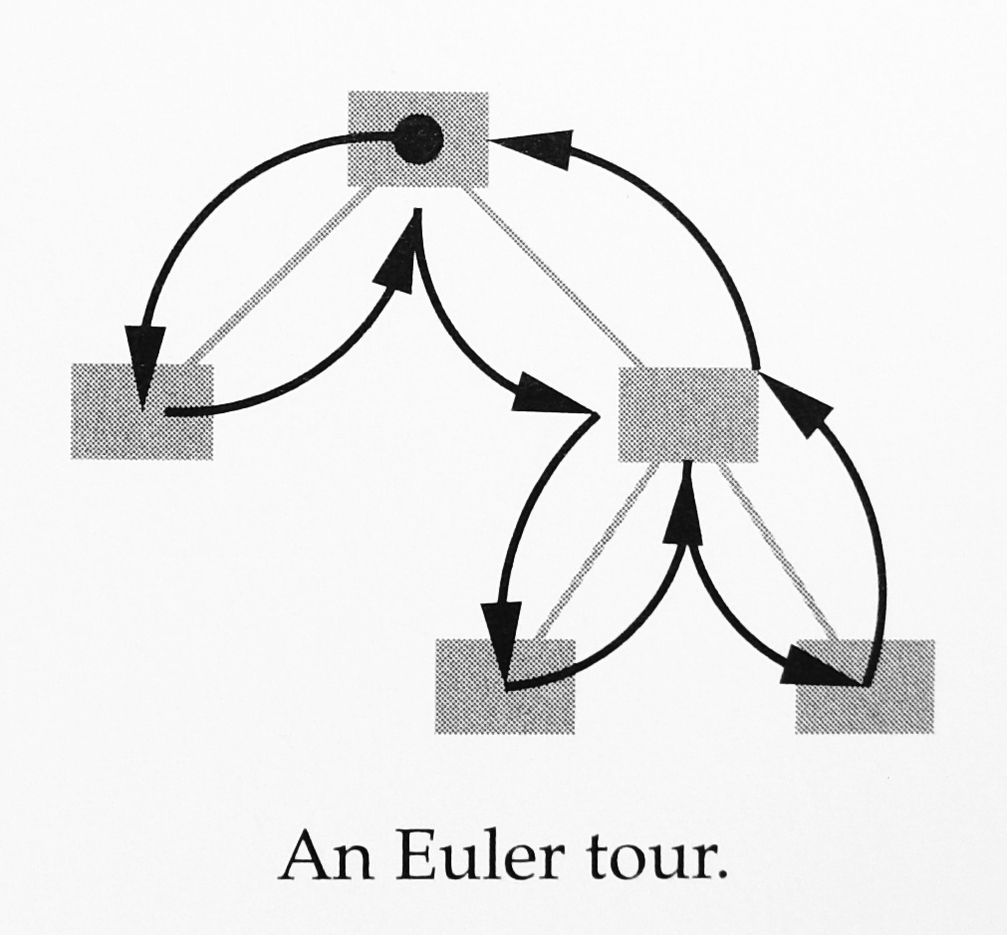
Trees
Operations
  Find
    Examine the value x in the current node.
      If it is the value we are looking for, stop.
    If the value we are looking for is less than x, then the value we are looking for must be in the left child of the current node or one of its descendants. Move to the left child.
      If there is no left child, then the value we are looking for does not exist in the tree.
    If the value we are looking for is greater than x, we move to the right child.
      If there is no right child, then the value we are looking for does not exist in the tree.
    Repeat from step 1.
  Addition
    First perform a “find” operation
    If the value does not exist in the tree, find operation gets to the leaf node that would have been the parent of our value.
    Find operation takes O(log k) time (the depth of the tree), and the creation of the new node takes constant time.
    Leading-order complexity is O(log k).
  Balancing the tree
    An unbalanced tree severely affected the speed of tree operations.
    “Pivots” rebalance operations take only O(log k)
  Deletion
    Find the value takes O(log k)
    Delete it and perform a “pivot” operation
    Can be complete in O(log k)
  Enumerating
    Euler tour
    Each edge is traversed twice and there are k-1 edges
    in a tree with k nodes → O(k) time

Slide 24
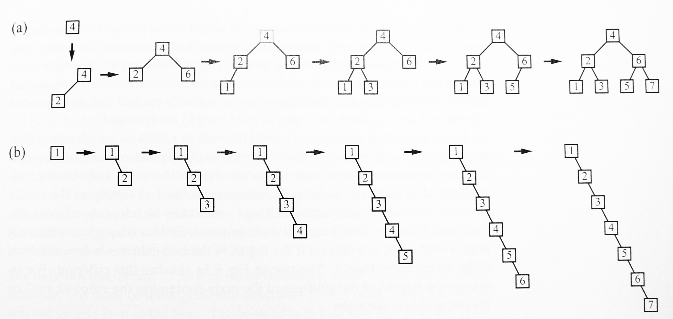
Balancing the tree
– simple solution
Randomize the order in which the elements are added.
Although the resulting tree is not completely,it will still have depth O(log k) on average.

Slide 25
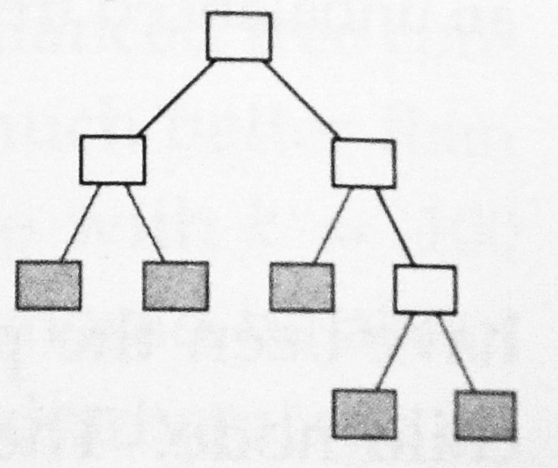
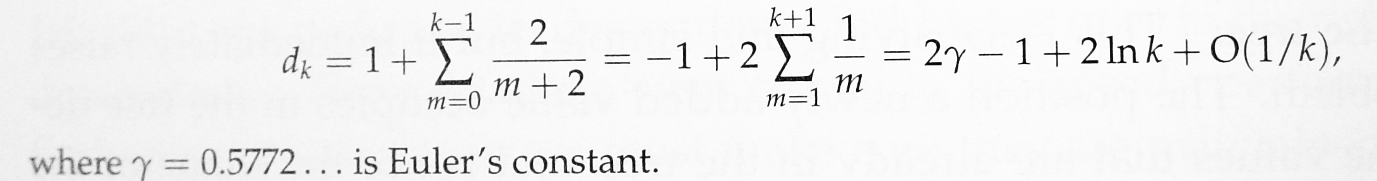
Proof
Consider the set of “empty nodes,” meaning the missing children immediately below current nodes in the tree
  gray boxes in the figure
Suppose when there are k nodes in total in the tree there are c_{k} such empty nodes
Their average depth is d_{k}
c_{k+1} = c_{k}+1. Noting that c₁ = 2, this implies that c_{k} = k+1.
c_{k+1}d_{k+1=}c_{k}d_{k}+d_{k}+2, where c_{k+1} = c_{k}+1 and c_{k+1} = k+2.
d_{k+1} = d_{k}+2/(k+2). Noting that d₁ = 2, this implies
Thus the average depth of the empty nodes is O(log k).

Slide 26
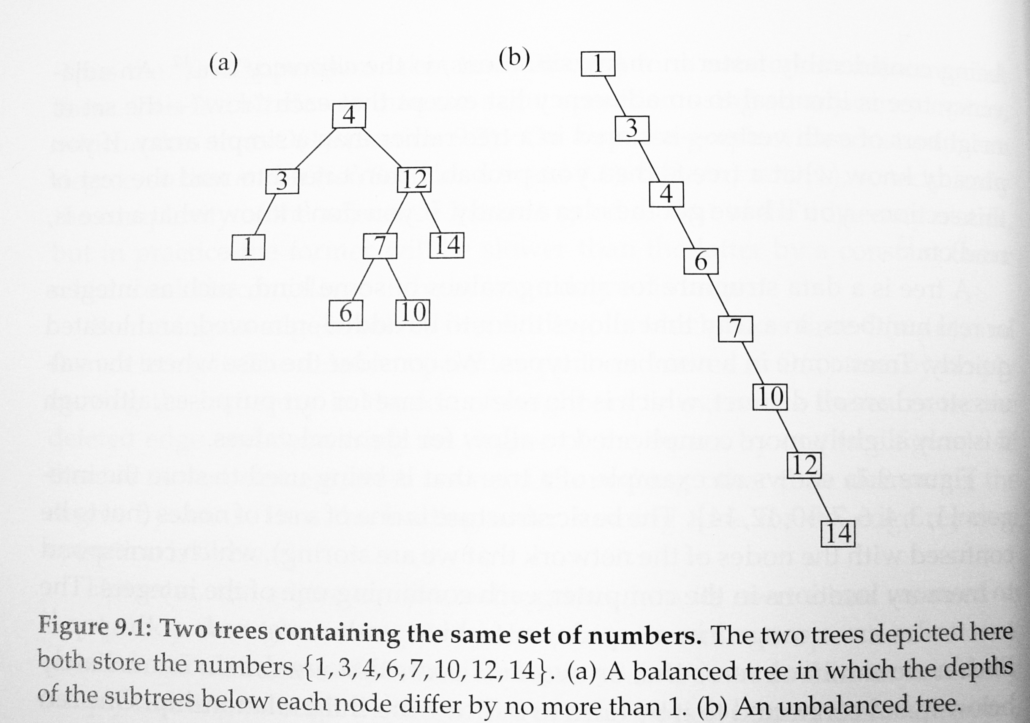
Depth of a tree

Slide 27
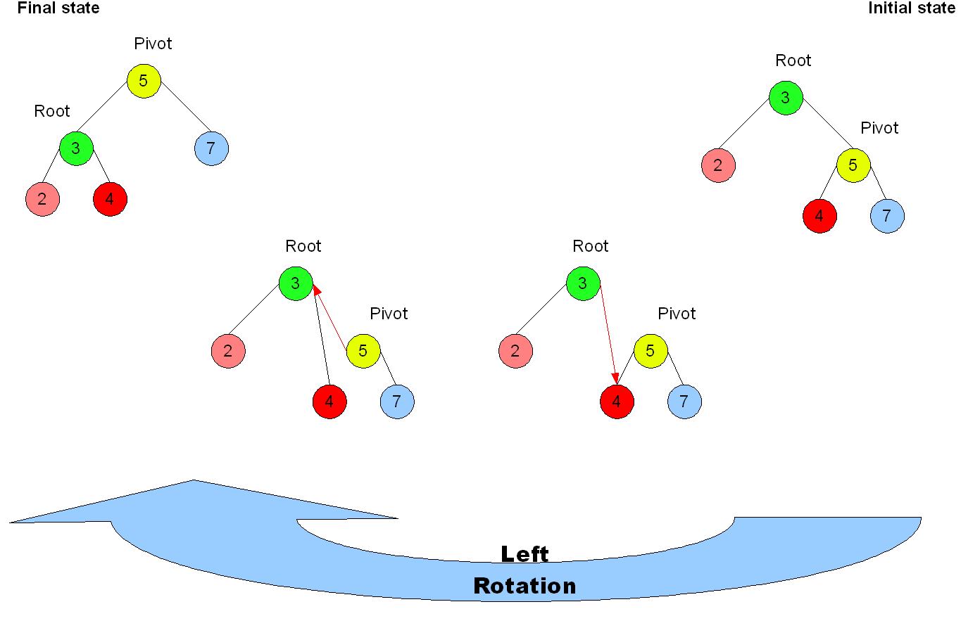
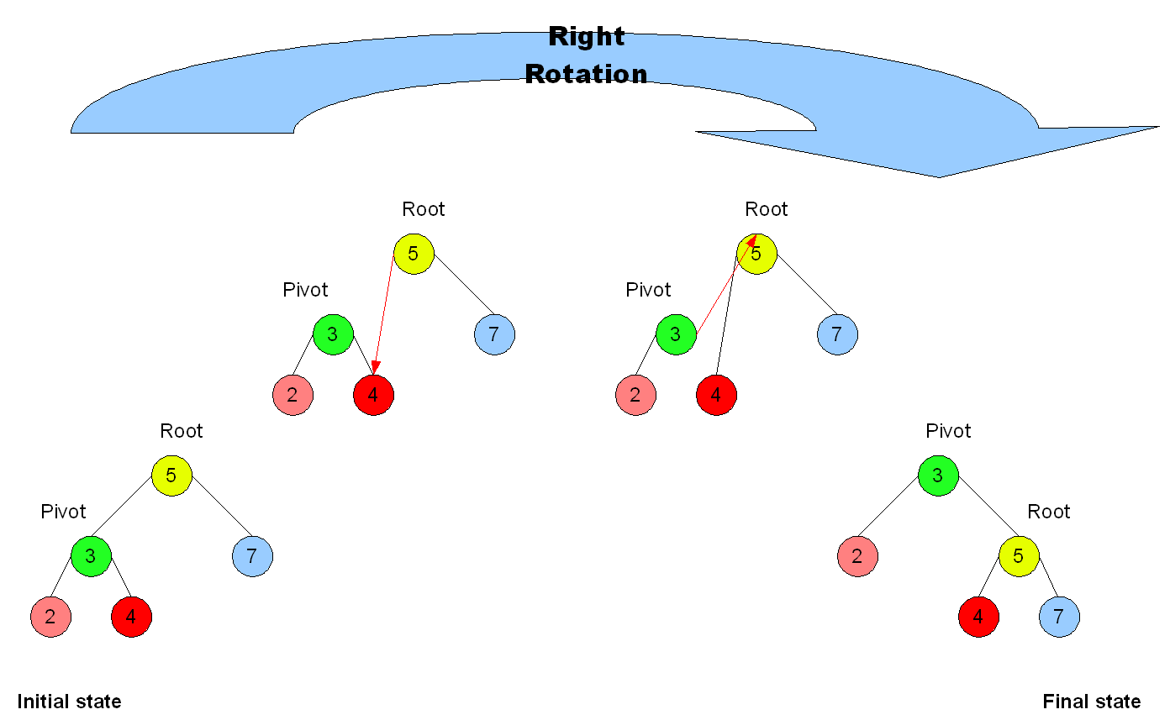
Pivot operation

Slide 28
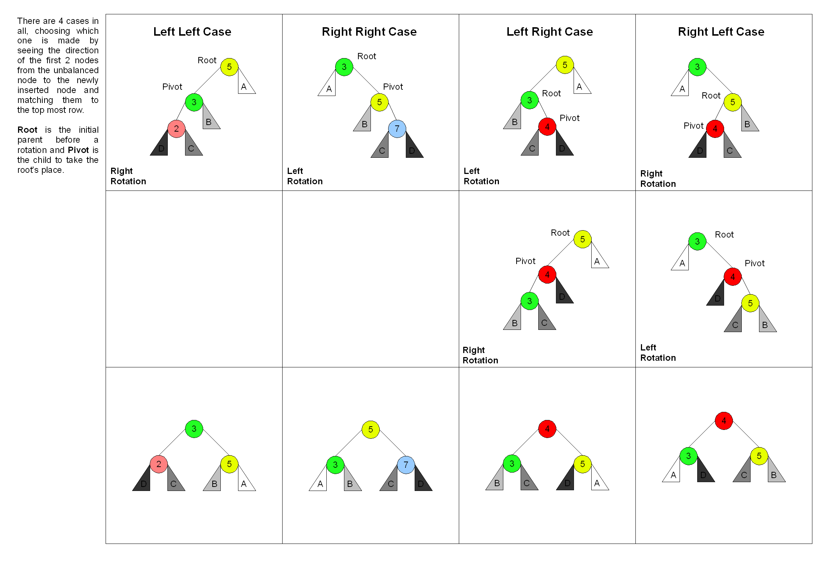
Rebalance the tree

Slide 29
Outline
Runing time and computational complexity
Storing network data
The adjacency matrix
The adjacency list
Trees
Other network representations
Heaps
Notes:
29

Slide 30
Other network representations
Hybrid matrix/list representations
  Optimal data structure
    Consists of an adjacency matrix and an adjacency list
    Non-zero elements in the adjacency matrix are accompanied by pointers that point to the corresponding elements in the adjacnecy list.
    Insert, delete and fined edges in O(1)
    Enumerate the neighbors of a given vertex in O(m/n)
Representations with variables on edges
  The edges have values, weights, or labels on them.
Edge lists
  (1,3), (4,1), (4,3), (4,5)
  The representation does not explicitly list vertices at all.
    There is no way to tell that a vertex even exists if it is not connected to any edges.
  Edge lists are often used as a way to store network structure in computer files on disk or other storage medium.

Slide 31
Outline
Runing time and computational complexity
Storing network data
The adjacency matrix
The adjacency list
Trees
Other network representations
Heaps
Notes:
31

Slide 32
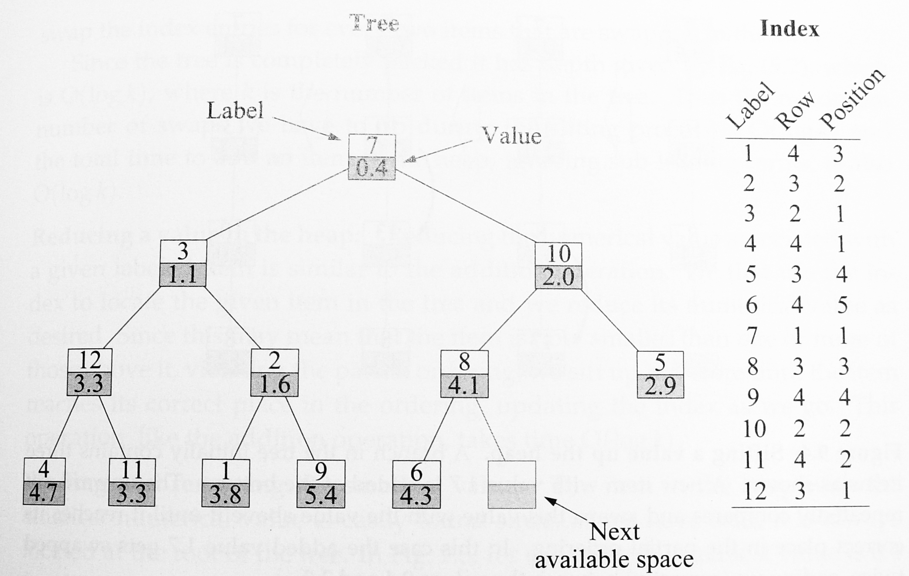
Heaps (binary heap)
The binary heap consists of two parts, a value and an index.
  The index tells us the location of each item in the tree
Two important features
  Always completely packed
    We fill the tree row by row by starting with the root node
  Partially ordered
    Each value is greater than or equal to the one above it in the tree and less than or equal to both of the two below it
    The value stored at the root node of the tree is always the smallest value

Slide 33
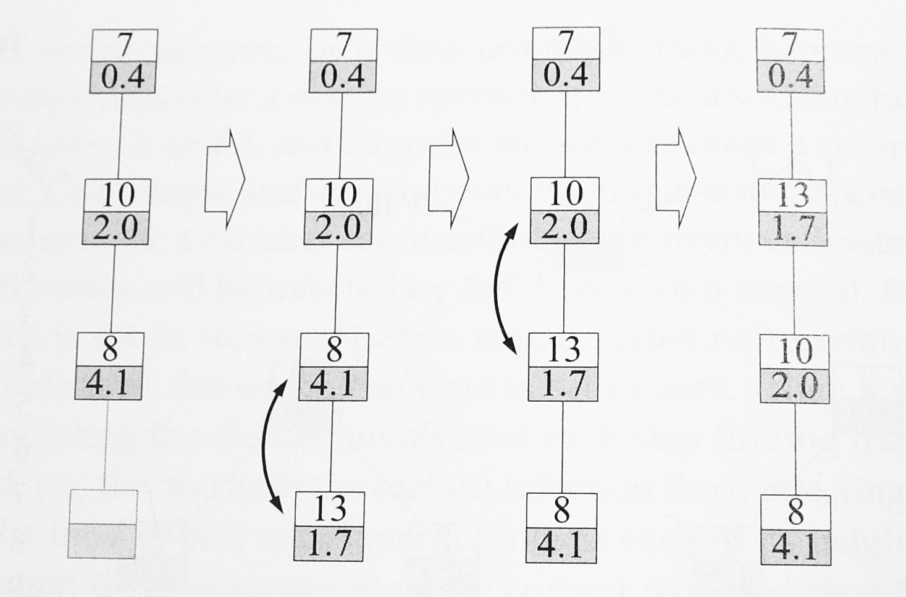
Heaps (binary heap)
Operations
  Adding an item
    Place it in the first available
    free space at the bottom of the tree
    Sifting the tree to restore partial order
  Reducing a value
    Use the index to locate the given item
    Reduce its numerical value as desired
    Shift up until the item reaches its correct place in the ordering
  Finding and removing the smallest value
    It is always located at the root of the tree.
    Leaves a hole in the tree
    Taking the last item from the bottom row of the tree and move it up to the root.
    Sifting down → swapping it with the smaller of the two below it
    Repeatedly, moving the item down the tree until it reaches a point at which it is smaller than both of the items below it, or it reaches the bottom of the tree.

